Slide 1

Rent Quest
Your Quest, Our Analysis
U.C.Berkeley Bootcamp Apr 2019
Prem Ganesh, Amitava Samaddar, Jason Zelaya
& Suvrangshu Ghosh

Slide 2

Finding a perfect rental at Bay Area
What are the best areas to search?
Which rentals have the most rooms available
Which locations have more availabilities?

Slide 3

Our Quest
We pulled rental data from a major web site:
Craigslist.org

Slide 4

API calls to web
Called API’s to obtain rental data
Picked multiple locations within the Bay Area that have available rentals
Processed more than 14,000 records

Slide 5

Data Selection & cleanup
Cleanup process
Selection Process
Multiple data scan
Removed special characters
Removed null values
Text to integer conversion
Description
Price
Location
Number of rooms
Geo Tags

Slide 6
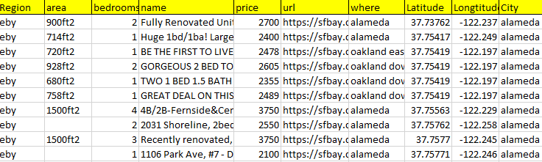
Final Data
The data is converted and stored in MongoDB
Craigslist

Slide 7

Problems faced
Collected data had latitude/Longitude in parenthesis
No proper city
Had to call city py to with lat/lon to get city
D3 library version issues
Leaflet taking long time to load for 14K+ data

Slide 8
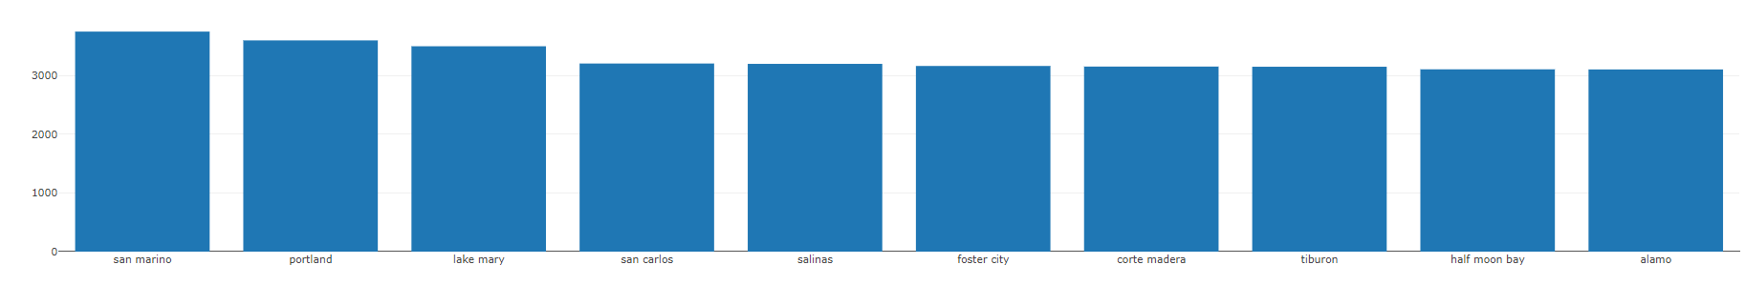
Benefit
Availability Vs Locations
Multiple analyses can be derived the data obtained
Which locations have cheap rentals?
Which locations have higher rental prices?
Average Price

Slide 9
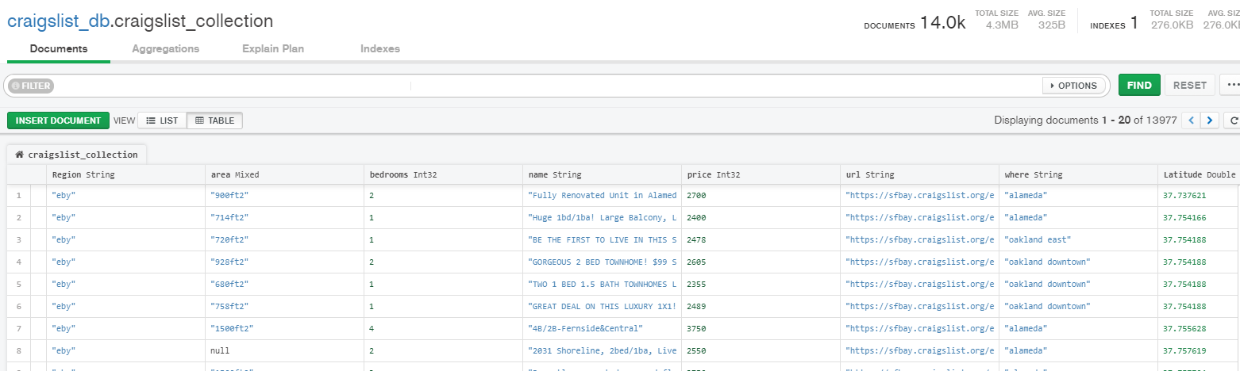
Database - mongodb
Showing collections Craigslist

Slide 10
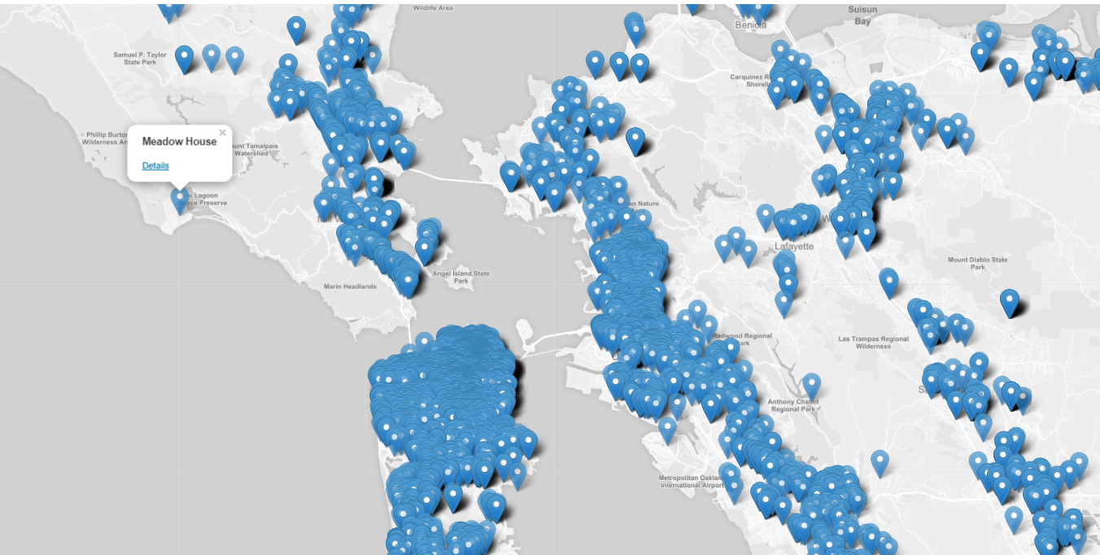
Data visualizations using D3, Leaflet

Slide 11

Conclusion
Our tool will help a user select their next home based on following:
Capacity to search for available rental city wise and region wise
Highest, lowest and average rental price
Rental availability based on bedroom(s)
Map allows the user having idea about the location

Slide 12
THANK YOU!

